Slide 1

Condition Variables
PASS
CS532: OS Foundations
Lab Assignment
Email: chitram2@pdx.edu & ramya3@pdx.edu

Slide 2
Instructions: Make a copy of this document, move your copy to your submissions folder and fill the document with your responses. Use the space on each slide to show your responses, and add additional slides as needed.
When ready for grading: complete the lab assignment submission form and include a link to your filled document

Slide 3
pingpong.c
Your assignment is to read, understand, build, run and fix the pingpong.c program so that its two threads correctly take turns printing their output lines. Begin by reading and understanding the source code which is linked from the course plan document.
Next, build and run the original program. When you run the original version it should fail.

Slide 4
1. Why does the original pingpong program fail? What is wrong with it?
The pingpong program failed because since the two threads can be run in any order. And ping thread is operating faster than the pong thread, the pong thread is ultimately unable to satisfy the condition and it failed.
Good

Slide 5
2. Modify the pingpong.c source code to produce a new version called pingpong2.c that correctly, consistently, successfully outputs the correct pattern of PING and PONG. Test pingpong2 with varying number of rounds such as 10, 100, 1000, 10000, etc. It should work every time, regardless of the number of Rounds. Your code must properly use a condition variable to coordinate the two threads taking turns.
Upload your pingpong2.c file to your submissions folder and provide a link to it here: link
https://docs.google.com/document/d/1ggwvx2ZDFhf-7qvIWUYFuvaglI7ZtlCcmLlNPXv0NrY/edit
Code looks good

Slide 6
void *PingerPonger(void *tidptr)
{
int tid = *((int *) tidptr);
for (unsigned dex = 0; dex <= NumRounds; dex++) {
pthread_mutex_lock(&mutex1);
while( PrevVal == tid)
{
pthread_cond_wait(&cond, &mutex1);
}
pingpongprint(tid);
PrevVal = tid;
pthread_cond_signal(&cond);
pthread_mutex_unlock(&mutex1);
}
return NULL;
}
Good

Slide 7
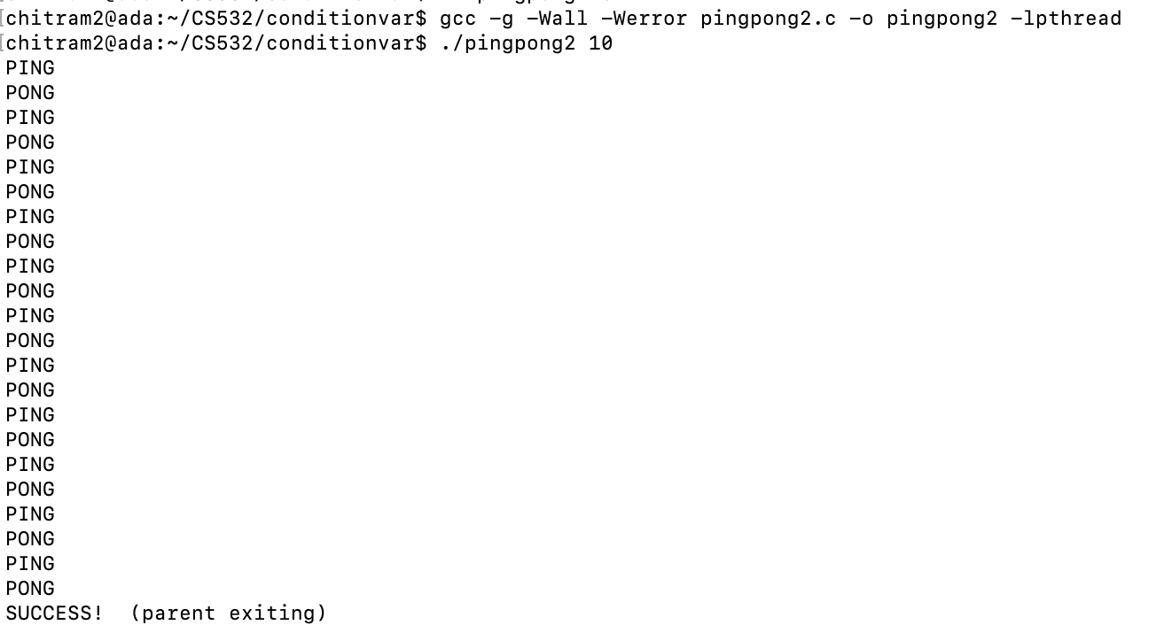
Good

Slide 8
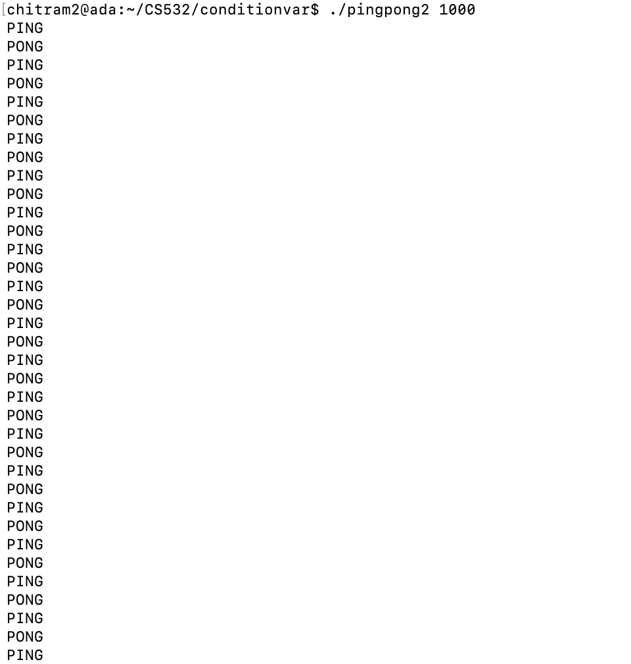
Good

Slide 9
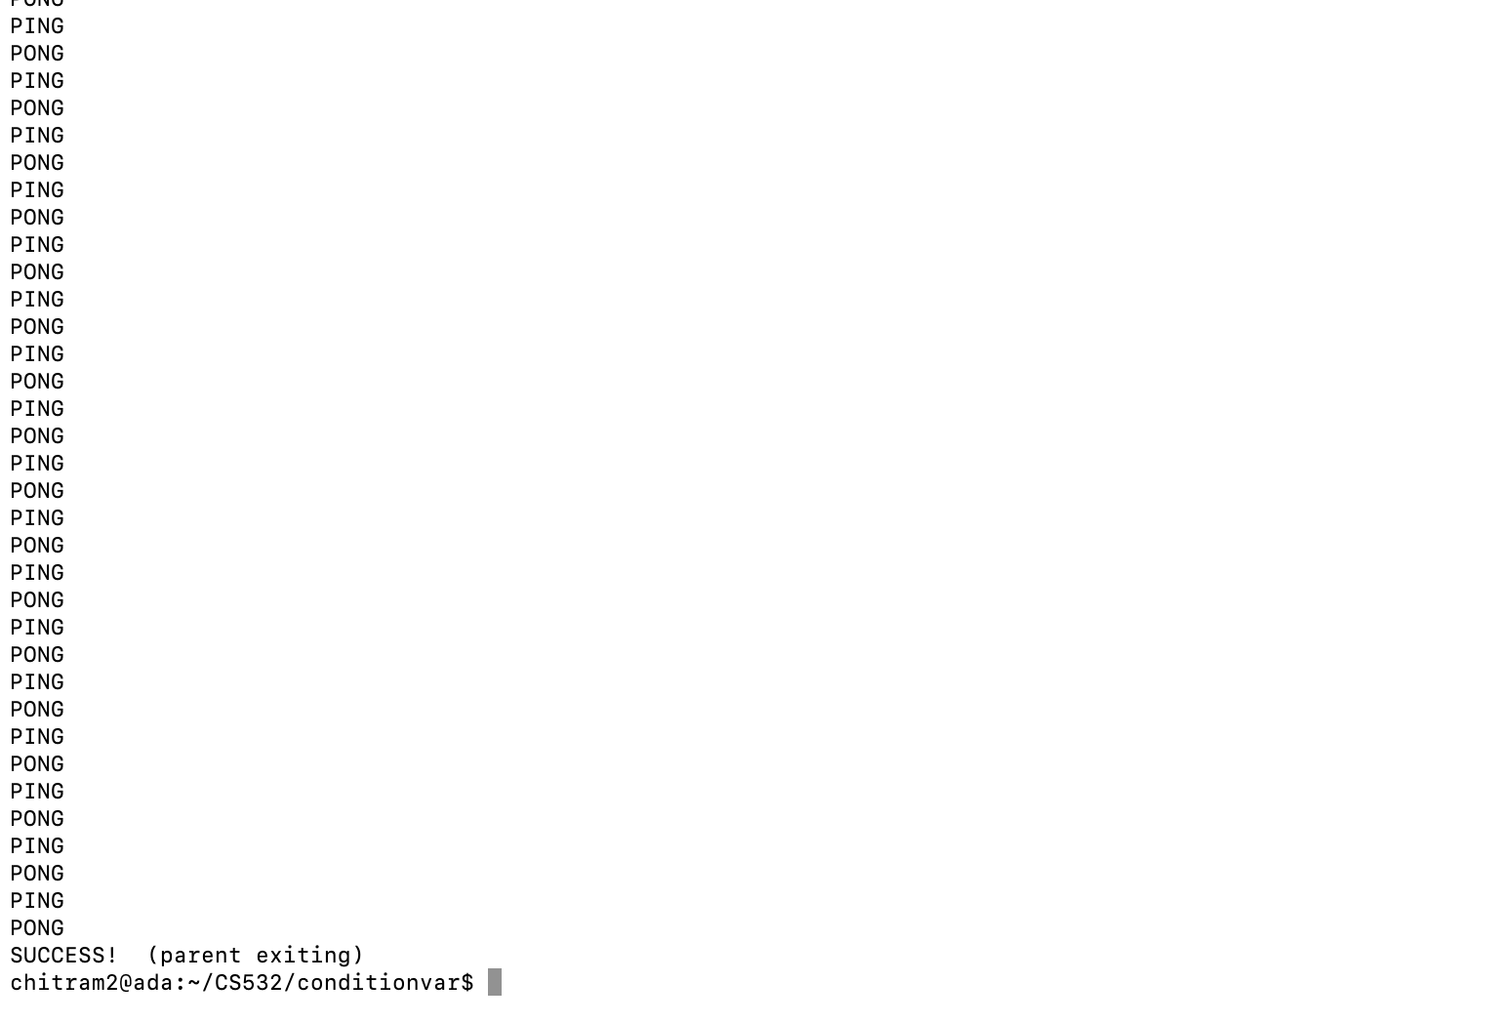

Slide 10
3. Could you have implemented pingpong2 correctly with nothing more than mutexes (i.e., without the use of condition variables)? Would it have been simpler that way?
Since pingpong is a producer consumer problem and it cannot implemented by just using mutex. It would definitely require condition variable for the correct implementation. One thread can print pong only when another thread sent ping. So, to have synchronization and to limit different executions of ping and pong thread, we definitely need to use condition variables.

